Slide 1


BAKERY SHOP
Subject Name: … WEB DEVLOPMENT WITH OPEN SOURCE Subject Code: ETVAWD009
Presented by:
VISHAL(2401010200)
KRISH(2401010227)
HEMANT(2401010262)
HIMANSHU(2401010264)
Section-C
Presented to:
Dr. Aarti

Slide 2
INTRODUCTION online Bakery shop allows users to check and purchase various bakery products available online. The project consists of list of bakery products displayed in various categories and the user can browse through the items. User can add the selected items it to his shopping cart. User needs to register on the site before checking out.

Slide 3
Table of Contents
1 ADMIN_TABLE
USERNAME_TABLE
ORDERS
ORDERS_PRODUCTS
PRODUCT_TABLES

Slide 4
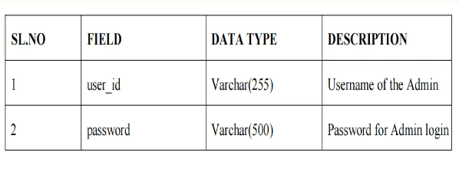
1. ADMIN_TABLE

Slide 5
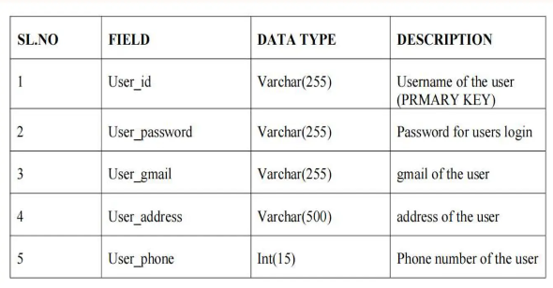
2.USERNAME_TABLE

Slide 6
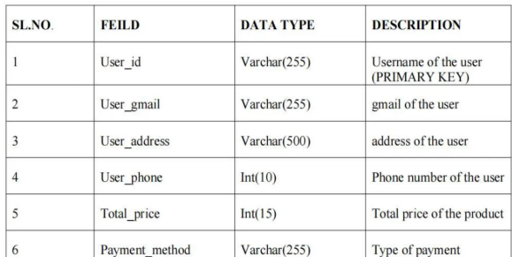
3. ORDERS

Slide 7
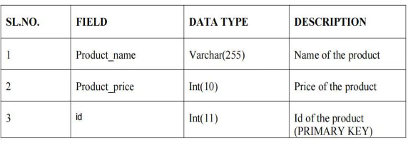
4.ORDERS_TABLE

Slide 8
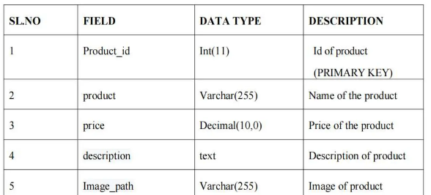
5. PRODUCT_TABLE

Slide 9
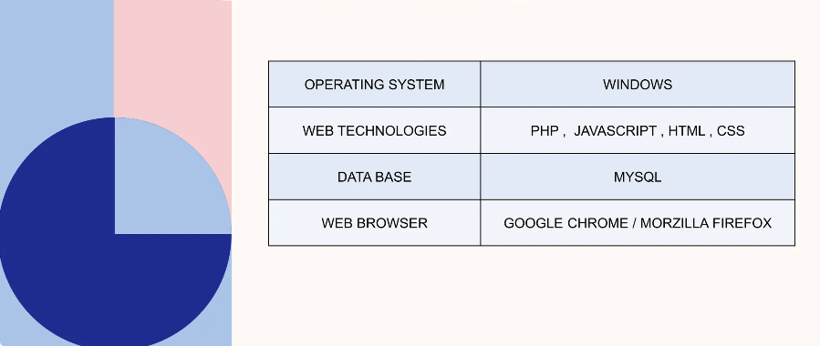
SOFTWARE REQUIRMENT SPECIFICATION

Slide 10
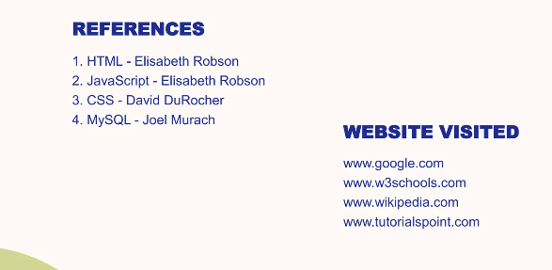
REFRENCE AND WEBSITE VISITED

